Slide 1




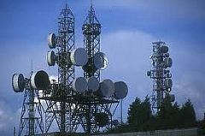
ELNG 307 – ANALOG AND DIGITAL COMMUNICATIONS

Slide 2
University of Energy and Natural Resources, Sunyani
Dept. of Computer & Electrical Eng.
ELNG 307 – ANALOG AND DIGITAL COMMUNICATIONS
Tweneboah-Koduah S.

Slide 3
Chapter 5 – Angle Modulation Techniques
Worrying does not empty tomorrow of its troubles, it empties today of its strength.
– Corrie ten Boom

Slide 4
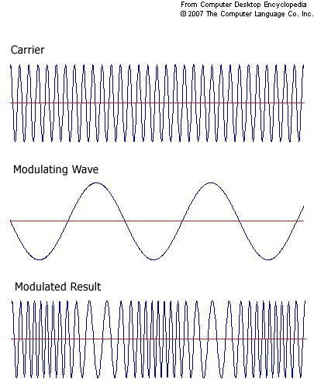
Angle (Exponential) modulation

Slide 5
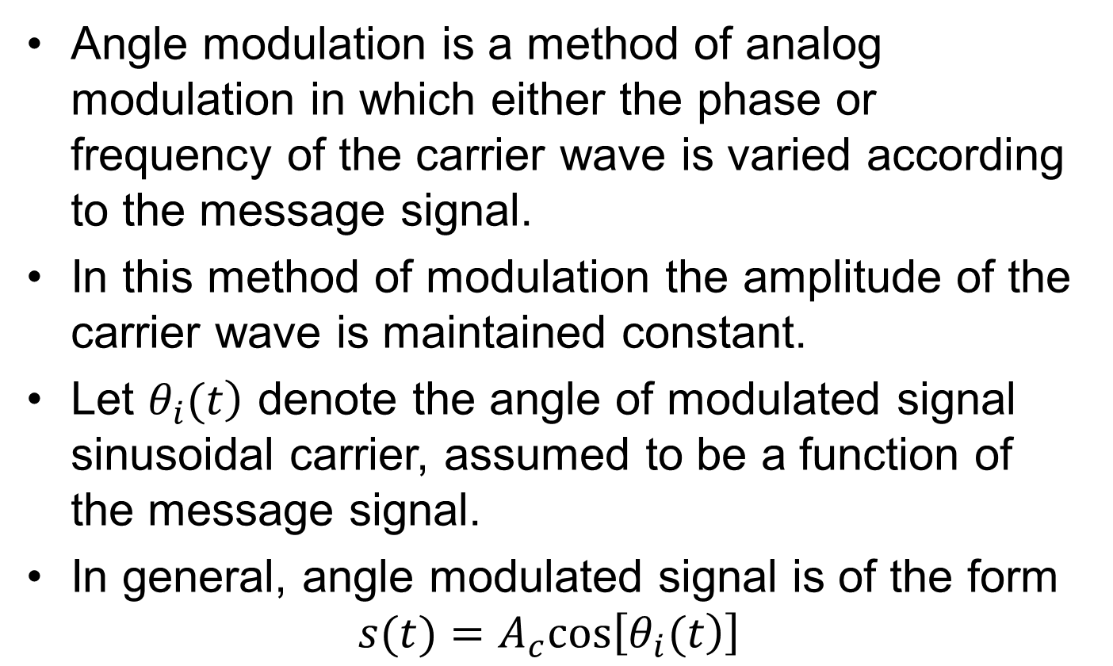
Angle modulation
Angle modulation is a method of analog modulation in which either the phase or frequency of the carrier wave is varied according to the message signal.
In this method of modulation the amplitude of the carrier wave is maintained constant.
Let $\left.θ_{i}(t\right)$ denote the angle of modulated signal sinusoidal carrier, assumed to be a function of the message signal.
In general, angle modulated signal is of the form
$$s(t)=A_{c}cos\left[\left.θ_{i}(t\right)\right]$$
Notes:
$$s(t)=A_{c}cos\left[\left.θ_{i}(t\right)\right]$$

Slide 6
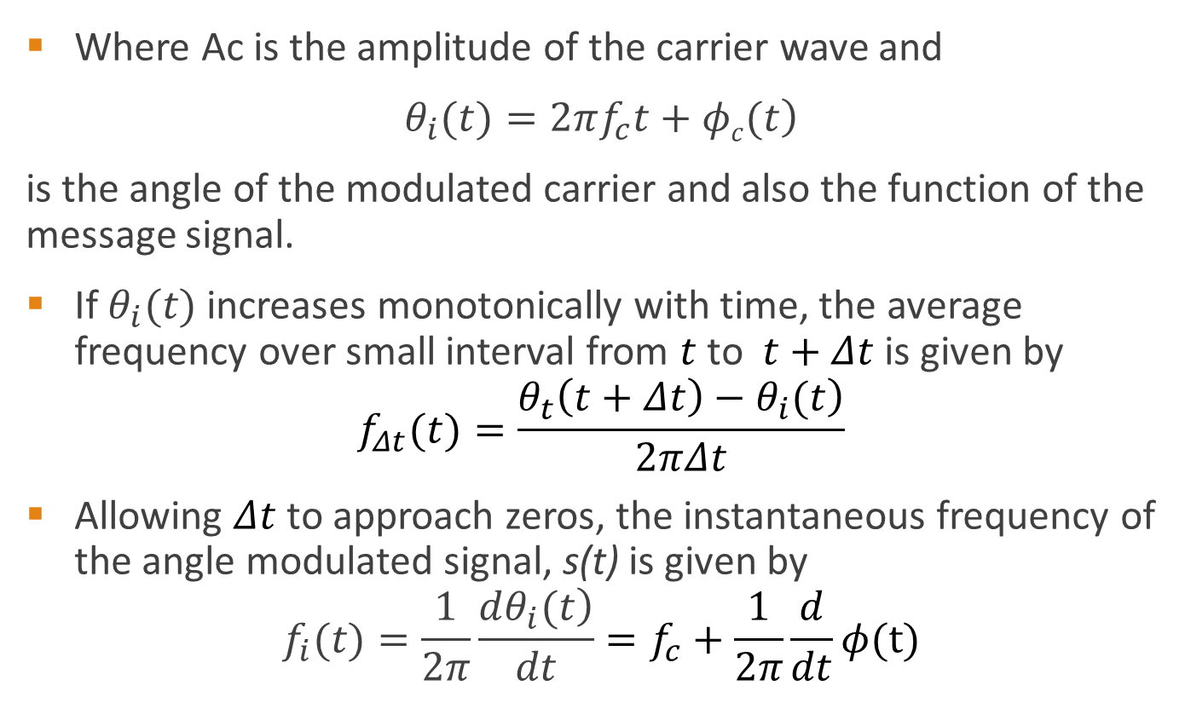
Angle modulation
Where Ac is the amplitude of the carrier wave and
$\left.θ_{i}(t)=2πf_{c}t+φc(t\right)$
is the angle of the modulated carrier and also the function of the message signal.
If $θ_{i}(t)$ increases monotonically with time, the average frequency over small interval from $t$ to $t+Δt$ is given by
$$f_{Δt}(t)=\frac{\left.θ_{t}\left(t+Δt\right)−θ_{i}(t\right)}{2πΔt}$$
Allowing $Δt$ to approach zeros, the instantaneous frequency of the angle modulated signal, s(t) is given by
$$f_{i}(t)=\frac{1}{2π}\frac{\left.dθ_{i}(t\right)}{dt}=f_{c}+\frac{1}{2π}\frac{d}{dt}φ(t)$$

Slide 7
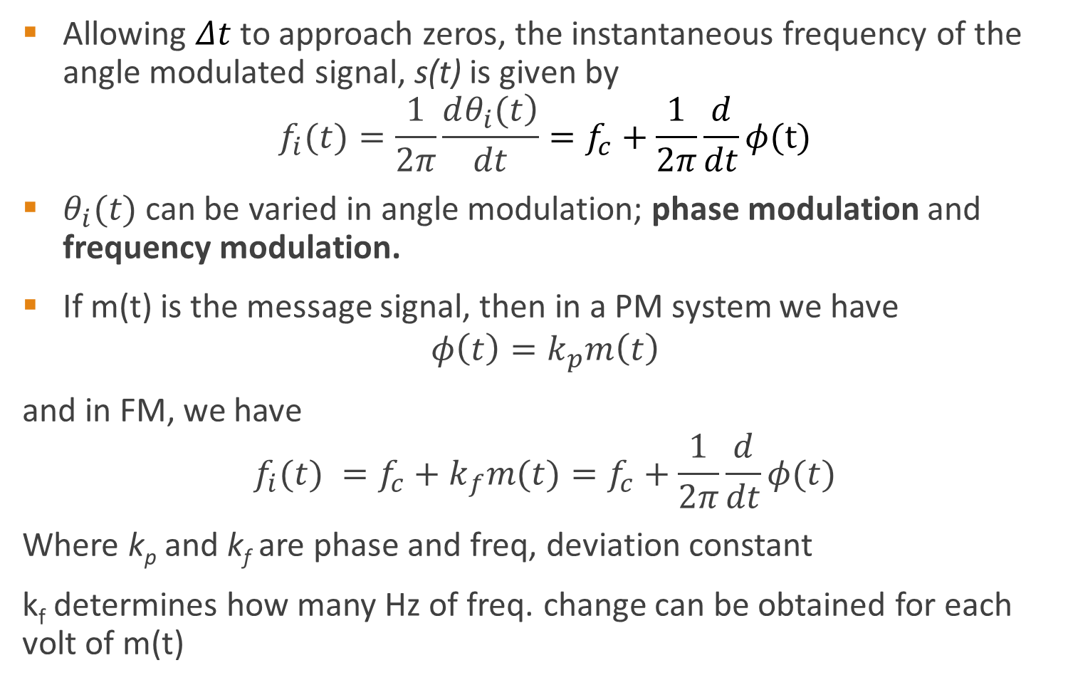
Angle modulation
Allowing $Δt$ to approach zeros, the instantaneous frequency of the angle modulated signal, s(t) is given by
$$f_{i}(t)=\frac{1}{2π}\frac{\left.dθ_{i}(t\right)}{dt}=f_{c}+\frac{1}{2π}\frac{d}{dt}φ(t)$$
$θ_{i}(t)$ can be varied in angle modulation; phase modulation and frequency modulation.
If m(t) is the message signal, then in a PM system we have
$$φ\left(t\right)=k_{p}m\left(t\right)$$
and in FM, we have
$$f_{i}(t) ={f_{c}+k}_{f}m(t)=f_{c}+\frac{1}{2π}\frac{d}{dt}φ(t)$$
Where k_{p} and k_{f} are phase and freq, deviation constant
k_{f} determines how many Hz of freq. change can be obtained for each volt of m(t)
Notes:
Here FM is varying carrier freq.

Slide 8
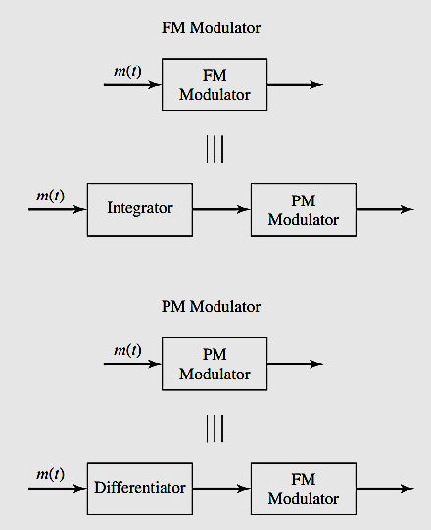
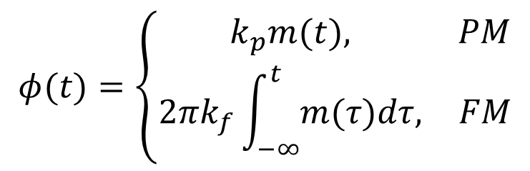
Angle modulation
We can then write this from the above analysis
$$φ(t)=\left\{\begin{matrix}k_{p}m(t), & PM \\ 2πk_{f}\int_{−∞}^{t}{m(τ)dτ,} & FM\end{matrix}\right.$$
There are two commonly used methods of angle modulation:
1. Frequency Modulation, and
2. Phase Modulation.
Notes:
$φ(t)$ is the phase of the signal

Slide 9
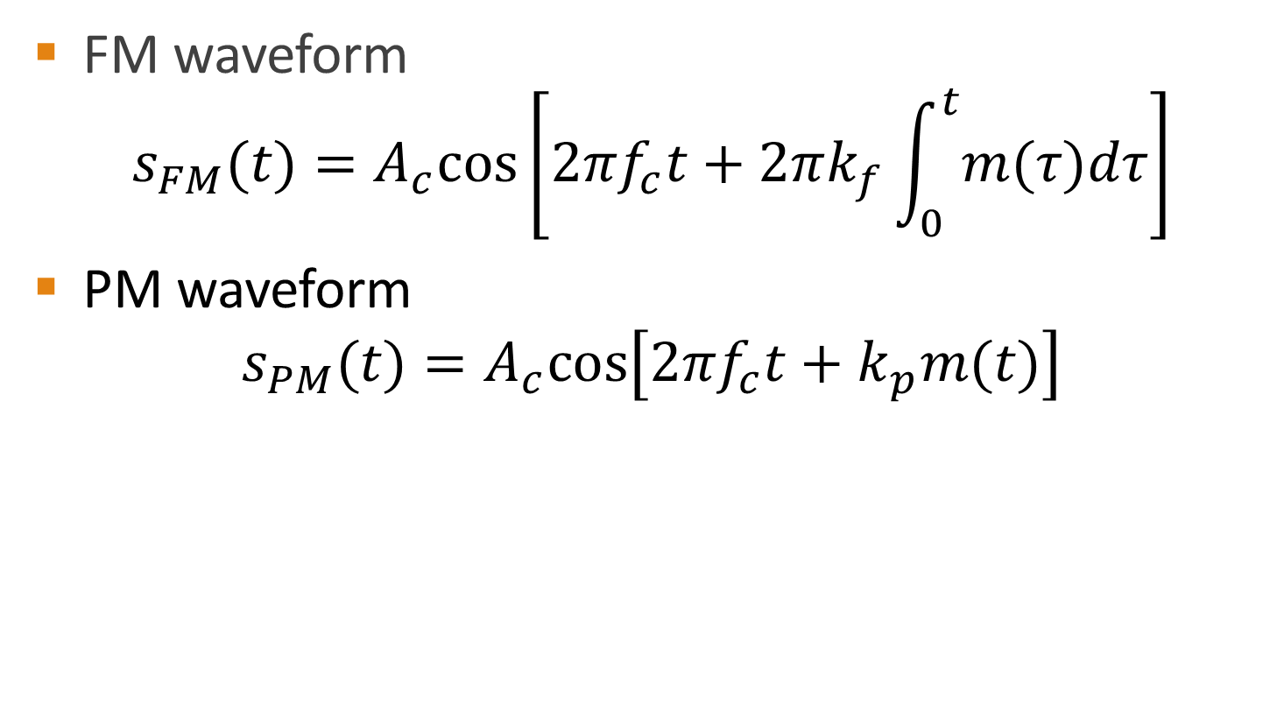
FM & PM waveform equation
FM waveform
$$s_{FM}(t)=A_{c}cos\left[2πf_{c}t+2πk_{f}\int_{0}^{t}{m(τ)dτ}\right]$$
PM waveform
$$s_{PM}(t)=A_{c}cos\left[2πf_{c}t+k_{p}m(t)\right]$$

Slide 10
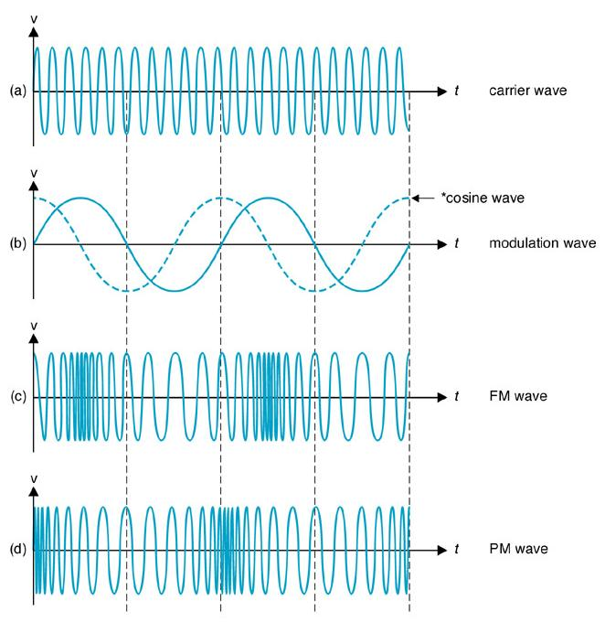
FM & PM waveforms
The FM and PM waveforms for sine-wave modulation: (a) carrier wave; (b) modulation wave; (c) FM wave; (d) PM wave.
(Note: The derivative of the modulating sine wave is the cosine wave shown by the dotted lines. The PM wave appears to be frequency modulated by the cosine wave.)

Slide 11
Properties of angle modulated waves
Constancy of power
Nonlinear
  Difficult to visualize waveforms
  Increase transmission bandwidth
  Noise immunity

Slide 12
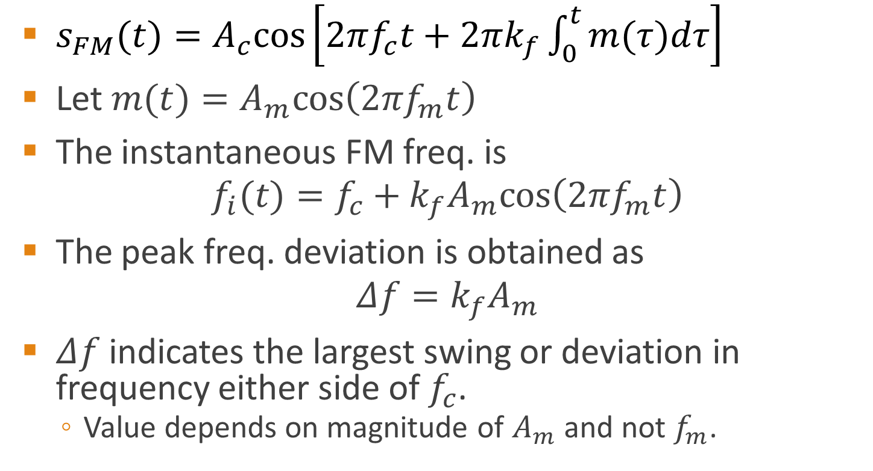
Frequency modulation – FM
$s_{FM}(t)=A_{c}cos\left[2πf_{c}t+2πk_{f}\int_{0}^{t}{m(τ)dτ}\right]$
Let $m(t)=A_{m}cos\left(2πf_{m}t\right)$
The instantaneous FM freq. is
$$f_{i}(t)=f_{c}+k_{f}A_{m}cos\left(2πf_{m}t\right)$$
The peak freq. deviation is obtained as
$$Δf=k_{f}A_{m}$$
$Δf$indicates the largest swing or deviation in frequency either side of $f_{c}$.
  Value depends on magnitude of $A_{m}$ and not $f_{m}$.
Notes:
f_i swing up and down either side of f_c over range of + or - k_{f}Am

Slide 13
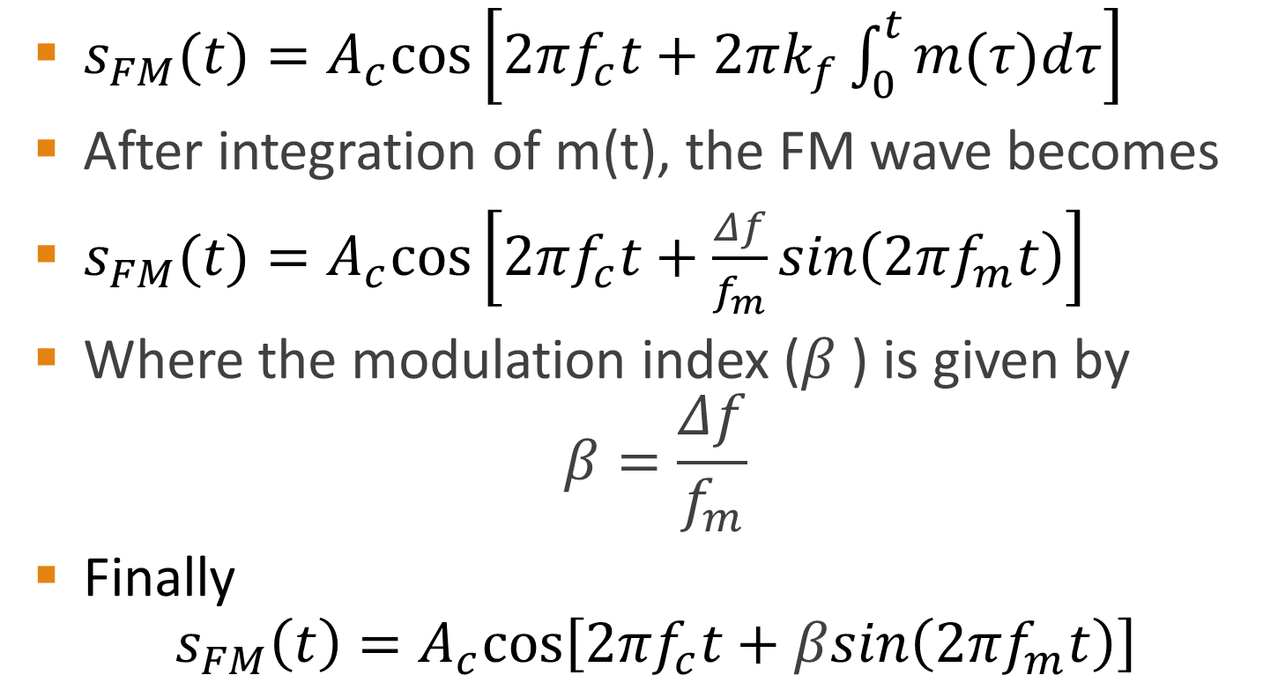
Frequency modulation – FM
$s_{FM}(t)=A_{c}cos\left[2πf_{c}t+2πk_{f}\int_{0}^{t}{m(τ)dτ}\right]$
After integration of m(t), the FM wave becomes
$s_{FM}(t)=A_{c}cos\left[2πf_{c}t+\frac{Δf}{f_{m}}sin\left(2πf_{m}t\right)\right]$
Where the modulation index ($β$) is given by
$$β=\frac{Δf}{f_{m}}$$
Finally
$$s_{FM}\left(t\right)=A_{c}cos\left[2πf_{c}t+βsin\left(2πf_{m}t\right)\right]$$
Notes:
f_i swing up and down either side of f_c over range of + or - k_{f}Am

Slide 14
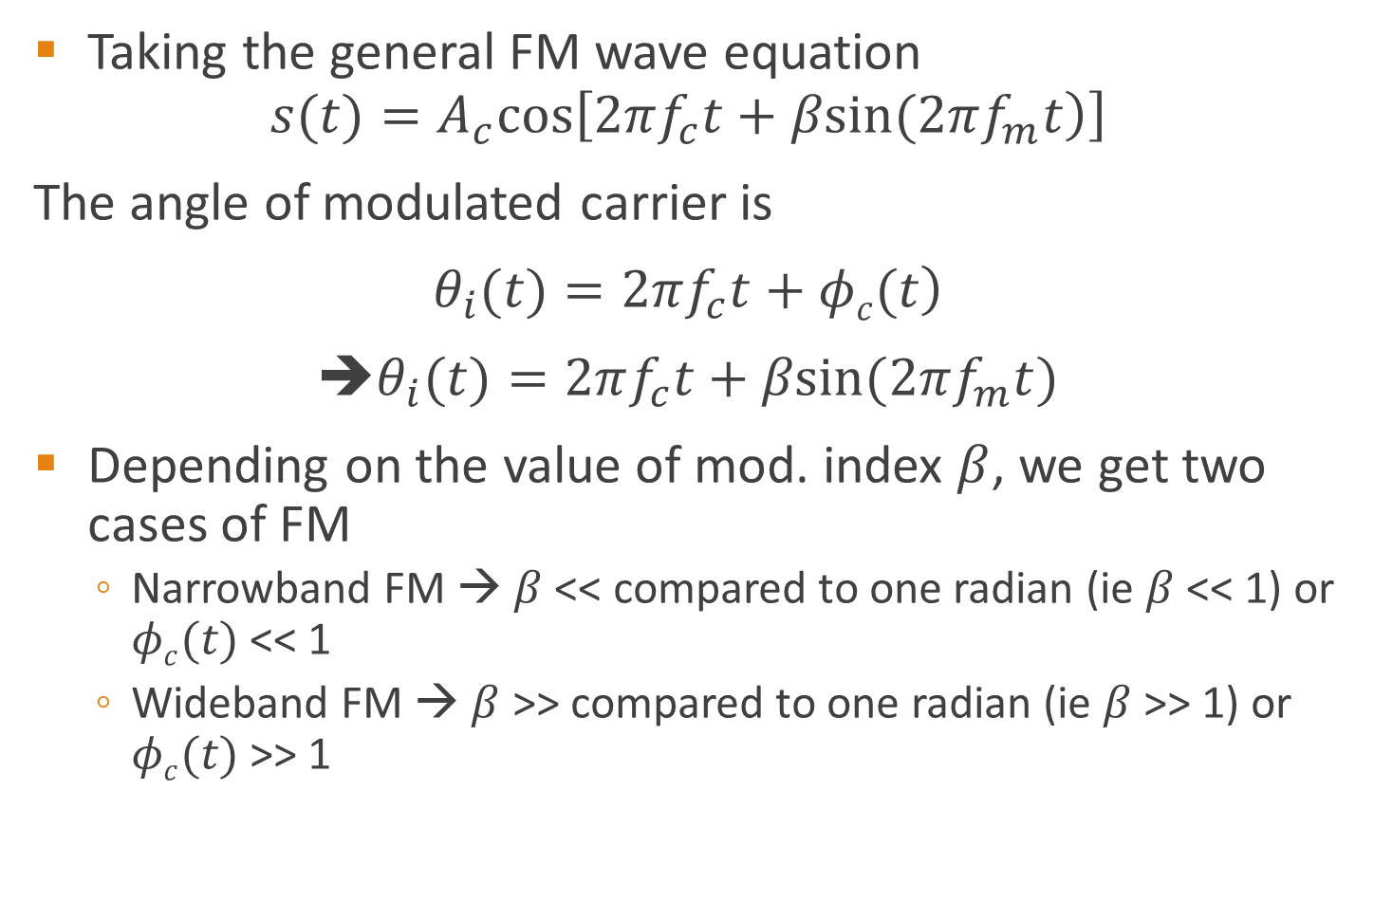
Frequency modulation – FM
Taking the general FM wave equation
$$s(t)=A_{c}cos\left[\left.2πf_{c}t+βsin(2πf_{m}t\right)\right]$$
The angle of modulated carrier is
$\left.θ_{i}(t)=2πf_{c}t+φc(t\right)$
➔$θ_{i}(t)=2πf_{c}t+βsin(2πf_{m}t)$
Depending on the value of mod. index $β$, we get two cases of FM
  Narrowband FM → $β$ << compared to one radian (ie $β$ << 1) or $φc(t)$ << 1
  Wideband FM → $β$ >> compared to one radian (ie $β$ >> 1) or $φc(t)$ >> 1

Slide 15
Example 5.1 pg 111
An 18 MHz carrier is modulated by a 400 Hz audio sine wave if the carrier voltage is 5.0 V and the maximum deviation is 12 kHz. Write down the equation for the modulated PM and FM wave.

Slide 16
Example 5.1 pg 114
Consider the message signal A_{m}cos(2π f_{m}t) is used to either frequency modulate or phase modulate the A_{c}cos(2π f_{c}t). Find the modulated signal in each case.

Slide 17
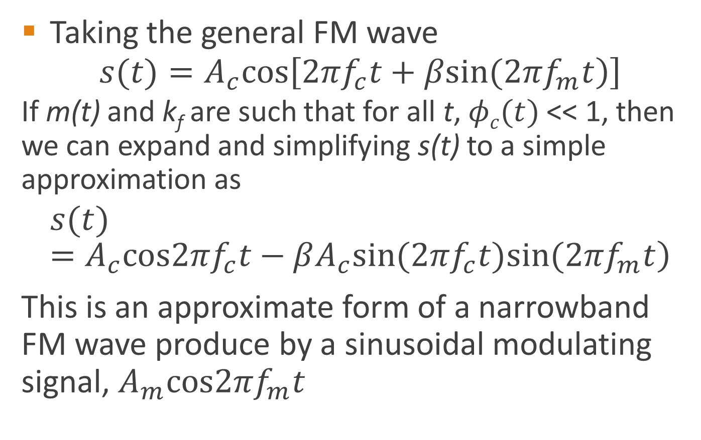
Narrowband FM
Taking the general FM wave
$$s(t)=A_{c}cos\left[\left.2πf_{c}t+βsin(2πf_{m}t\right)\right]$$
  If m(t) and k_{f} are such that for all t, $φc(t)$ << 1, then we can expand and simplifying s(t) to a simple approximation as
$$\left.s(t)=A_{c}cos2πf_{c}t−βA_{c}sin(2πf_{c}t)sin(2πf_{m}t\right)$$
This is an approximate form of a narrowband FM wave produce by a sinusoidal modulating signal, $A_{m}cos2πf_{m}t$
Notes:
$$\left.s(t)=A_{c}cos2πf_{c}t−βA_{c}sin(2πf_{c}t)sin(2πf_{m}t\right)$$

Slide 18
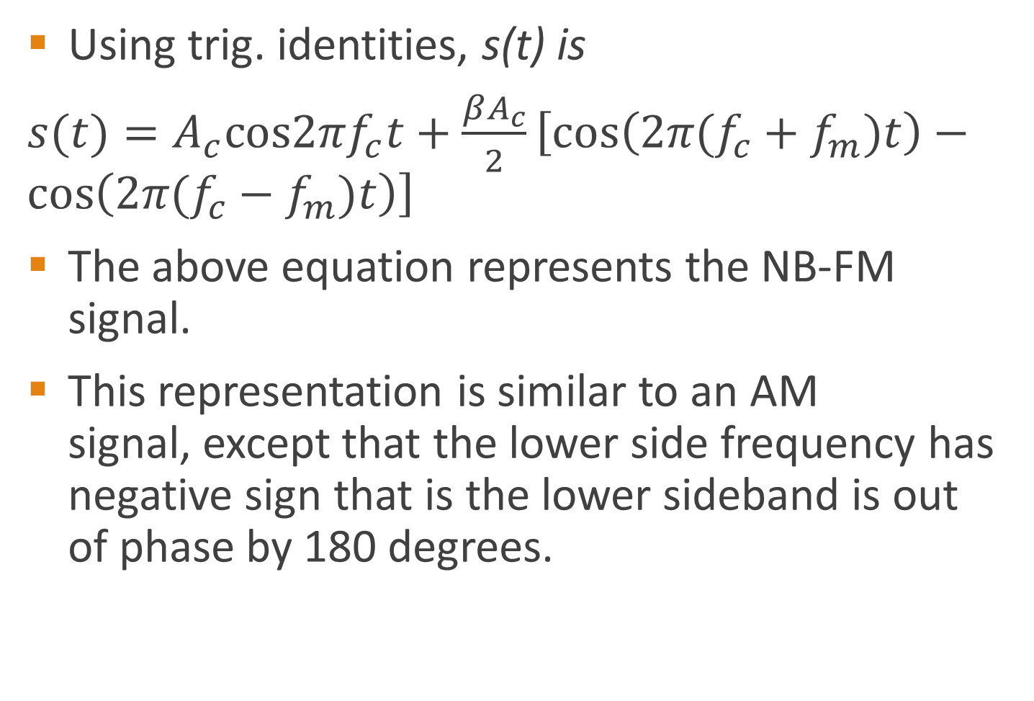
Narrowband FM
Using trig. identities, s(t) is
$s(t)=A_{c}cos2πf_{c}t+\frac{βA_{c}}{2}\left[cos\left(2π(f_{c}+f_{m})t\right)−cos\left(2π(f_{c}−f_{m})t\right)\right]$
The above equation represents the NB-FM signal.
This representation is similar to an AM
signal, except that the lower side frequency has negative sign that is the lower sideband is out of phase by 180 degrees.
Notes:
$$s(t)=A_{c}cos2πf_{c}t+\frac{βA_{c}}{2}\left[cos\left(2π(f_{c}+f_{m})t\right)−cos\left(2π(f_{c}−f_{m})t\right)\right]$$

Slide 19
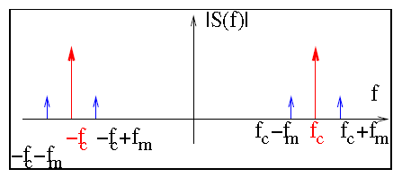
Narrowband FM
The magnitude spectrum of NB-FM signal is as shown below, → this is similar to AM signal spectrum.
The bandwidth of the NB-FM signal is 2f_{m}, which is same as AM signal
Notes:
$$s(t)=A_{c}cos2πf_{c}t+\frac{βA_{c}}{2}\left[cos\left(2π(f_{c}+f_{m})t\right)−cos\left(2π(f_{c}−f_{m})t\right)\right]$$

Slide 20


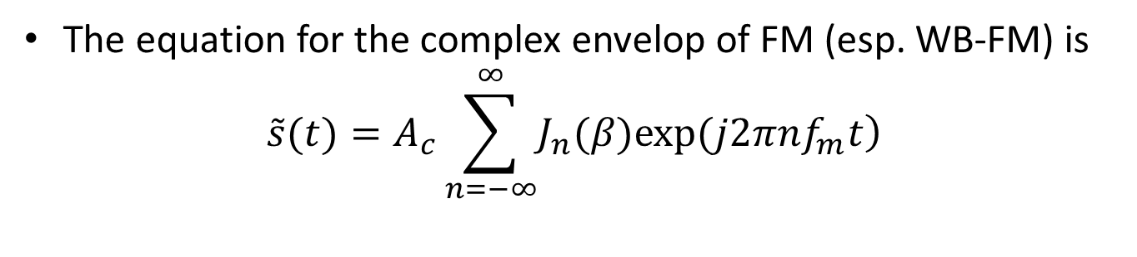
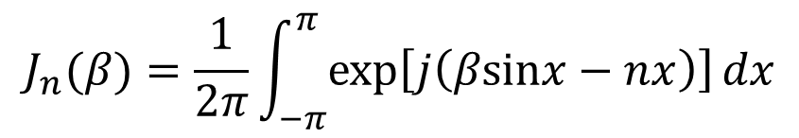

Bessel function $\left.J_{n}(β\right)$
The plot below is $\left.J_{n}(β\right)$ for different n and $β$
$$J_{n}(β)=\frac{1}{2π}\int_{−π}^{π}{exp\left[j\left(βsinx−nx\right)\right]}dx$$
The equation for the complex envelop of FM (esp. WB-FM) is
$$\tilde{s}(t)=A_{c}\sum_{n=−∞}^{∞}{\left.J_{n}(β)exp(j2πnf_{m}t\right)}$$
Taking the real value of s(t), we get
$$s(t)=\sum_{n=−∞}^{∞}{A_{c}J_{n}(β)cos\left(2π(f_{c}+nf_{m})t\right)}$$
Notes:
$$n=0,±1,±2,...$$

Slide 21
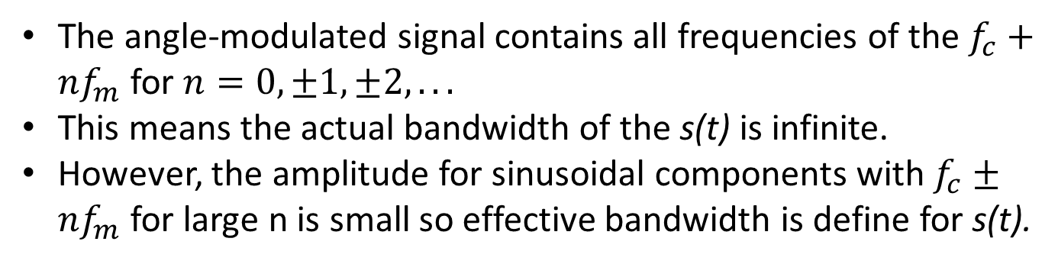

Bessel function $\left.J_{n}(β\right)$
Taking the real value of s(t), we get
$$s(t)=\sum_{n=−∞}^{∞}{A_{c}J_{n}(β)cos\left(2π(f_{c}+nf_{m})t\right)}$$
Eqn. 5
Note:
The angle-modulated signal contains all frequencies of the $f_{c}+nf_{m}$ for $n=0,±1,±2,...$
This means the actual bandwidth of the s(t) is infinite.
However, the amplitude for sinusoidal components with $f_{c}±nf_{m}$ for large n is small so effective bandwidth is define for s(t).
A simple expansion of Eqn. 5 gives
Notes:
$$n=0,±1,±2,...$$

Slide 22
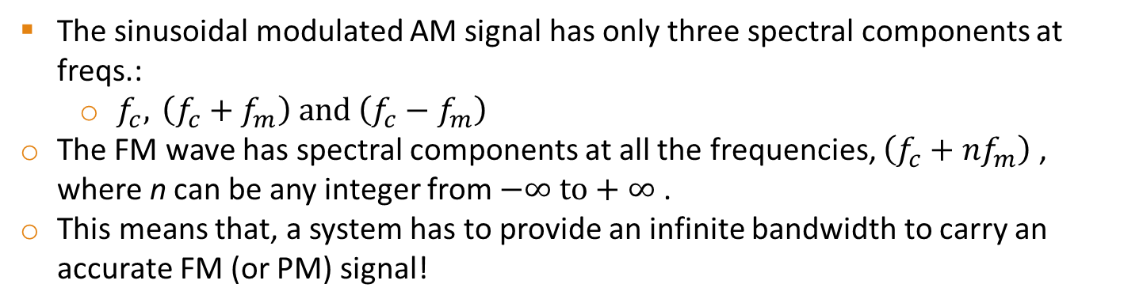
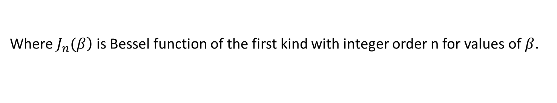
Bessel function $\left.J_{n}(β\right)$
A simple expansion of Eqn. 5 gives
Where $\left.J_{n}(β\right)$ is Bessel function of the first kind with integer order n for values of $β$.
The sinusoidal modulated AM signal has only three spectral components at freqs.:
  $f_{c}, \left(f_{c}+f_{m}\right) \text{and} \left(f_{c}−f_{m}\right)$
The FM wave has spectral components at all the frequencies, $\left(f_{c}+{nf}_{m}\right)$ , where n can be any integer from $−∞ to+∞$ .
This means that, a system has to provide an infinite bandwidth to carry an accurate FM (or PM) signal!
Notes:
$$n=0,±1,±2,...$$

Slide 23
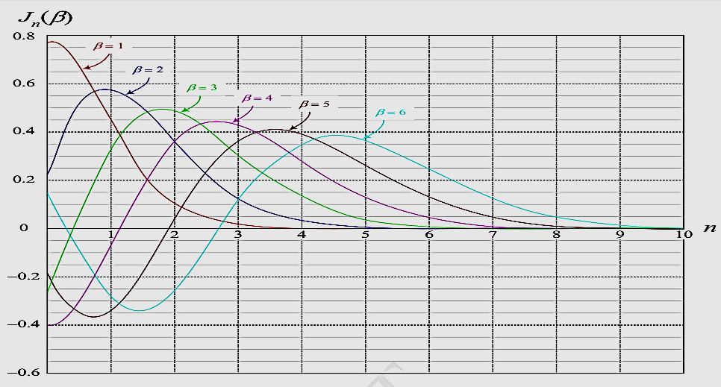
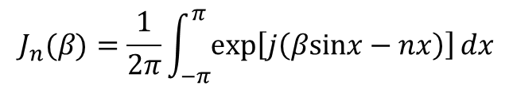

Bessel function $\left.J_{n}(β\right)$
The plot below is $\left.J_{n}(β\right)$ for different n and $β$
$$J_{n}(β)=\frac{1}{2π}\int_{−π}^{π}{exp\left[j\left(βsinx−nx\right)\right]}dx$$

Slide 24
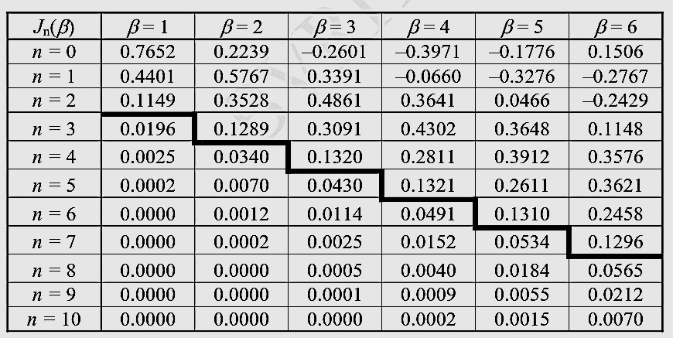
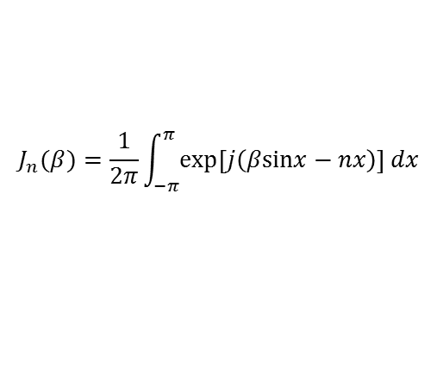
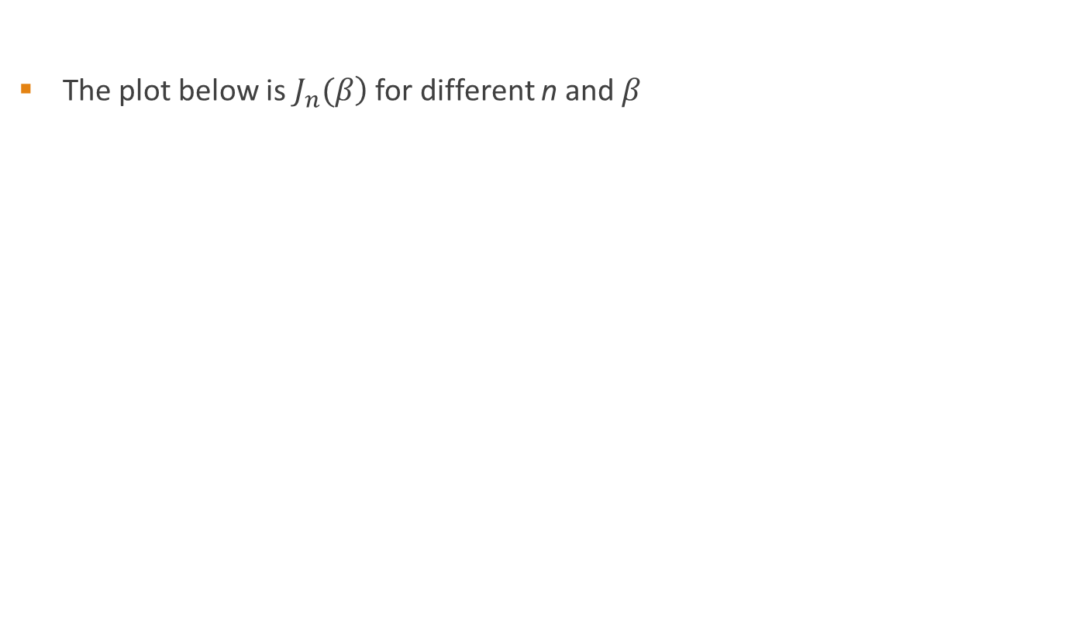
Bessel function $\left.J_{n}(β\right)$
The plot below is $\left.J_{n}(β\right)$ for different n and $β$
$$J_{n}(β)=\frac{1}{2π}\int_{−π}^{π}{exp\left[j\left(βsinx−nx\right)\right]}dx$$
Table of Bessel functions
Notes:
$$\tilde{s}(t)=A_{c}\sum_{n=−∞}^{∞}{\left.J_{n}(β)exp(j2πnf_{m}t\right)}$$

Slide 25
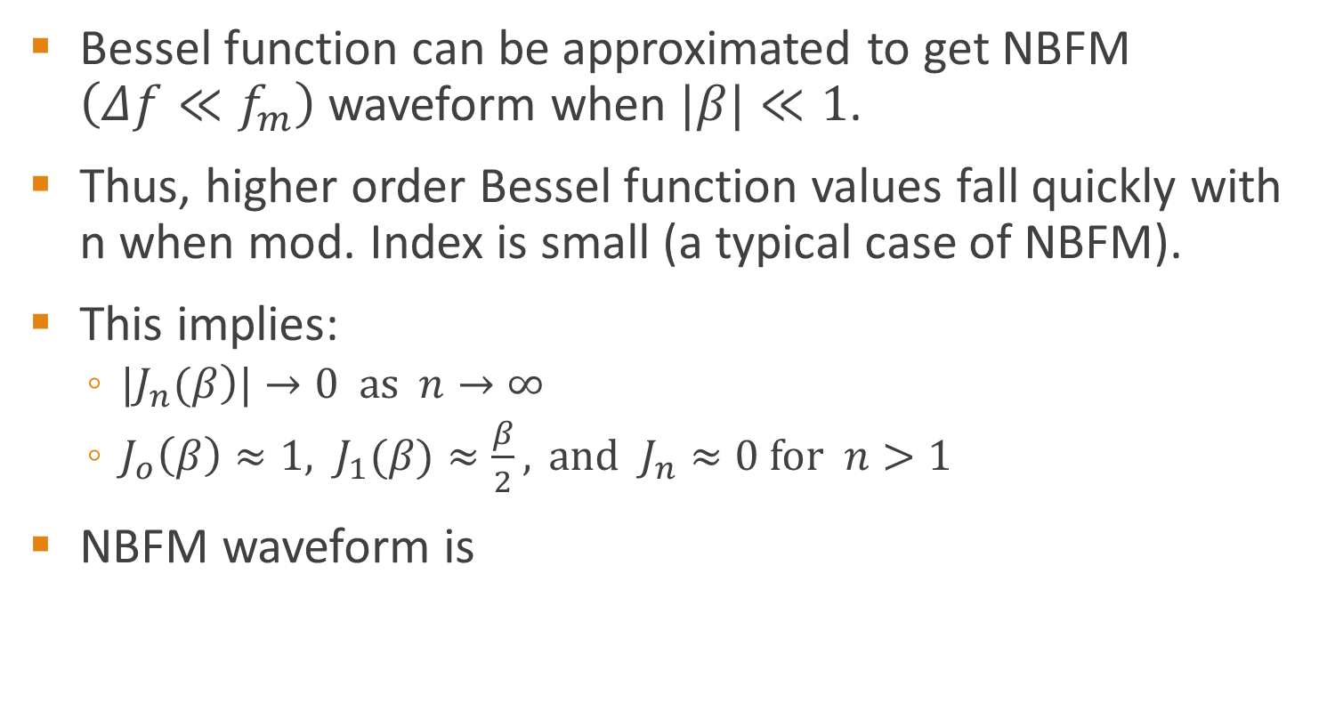

Bessel function $\left.J_{n}(β\right)$ – NBFM
Bessel function can be approximated to get NBFM $\left(Δf≪f_{m}\right)$ waveform when $|β|≪1$.
Thus, higher order Bessel function values fall quickly with n when mod. Index is small (a typical case of NBFM).
This implies:
  $|\left.J_{n}(β\right)|→0 \text{as} n→∞$
  $J_{o}\left(β\right)≈1, J_{1}(β)≈\frac{β}{2}, \text{and} J_{n}≈0 \text{for} n>1$
NBFM waveform is

Slide 26


Bessel function $\left.J_{n}(β\right)$ – WBFM
WBFM waveform depends highly on $|β|>1$
The total spectrum can be seen to consist of the carrier plus an infinite number of sidebands spreading out on either side of the carrier at integral multiples of the modulating frequency

Slide 27
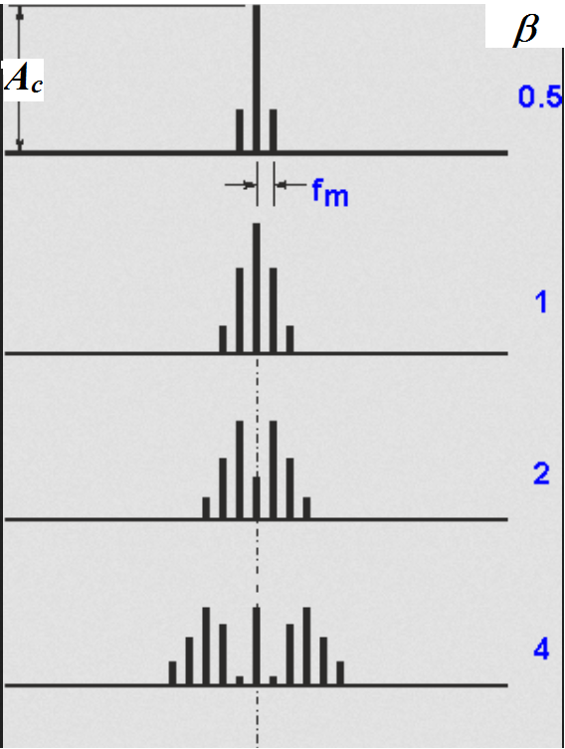
Spectrum of WBFM

Slide 28
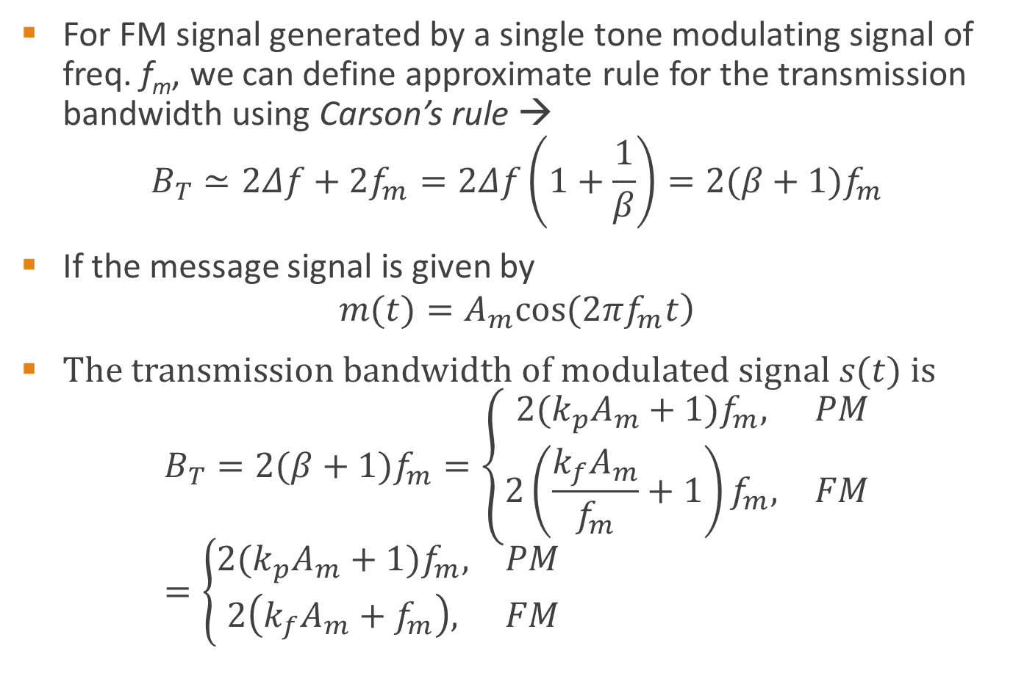
Transmission bandwidth of FM (WB)
For FM signal generated by a single tone modulating signal of freq. f_{m}, we can define approximate rule for the transmission bandwidth using Carson’s rule →
$$B_{T}≃2Δf+2f_{m}=2Δf\left(1+\frac{1}{β}\right)=2(β+1)f_{m}$$
If the message signal is given by
$$\left.m(t)=A_{m}cos(2πf_{m}t\right)$$
$\text{The} \text{transmission} \text{bandwidth} \text{of} \text{modulated} \text{signal} s(t) \text{is}$
$$B_{T}=2(β+1)f_{m}=\left\{\begin{matrix}2(k_{p}A_{m}+1)f_{m}, & PM \\ 2\left(\frac{k_{f}A_{m}}{f_{m}}+1\right)f_{m}, & FM\end{matrix}\right.=\left\{\begin{matrix}2(k_{p}A_{m}+1)f_{m}, & PM \\ 2\left(k_{f}A_{m}+f_{m}\right), & FM\end{matrix}\right.$$
Notes:
In theory, an FM signal contains an infinite number of side frequencies so that the bandwidth required to transmit such a signal is similarly infinite in extent. In practice, however, we find that the FM signal is effectively limited to a finite number of significant side frequencies compatible with a specified amount of distortion.
We may therefore specify an effective bandwidth required for the transmission of an FM signal.

Slide 29
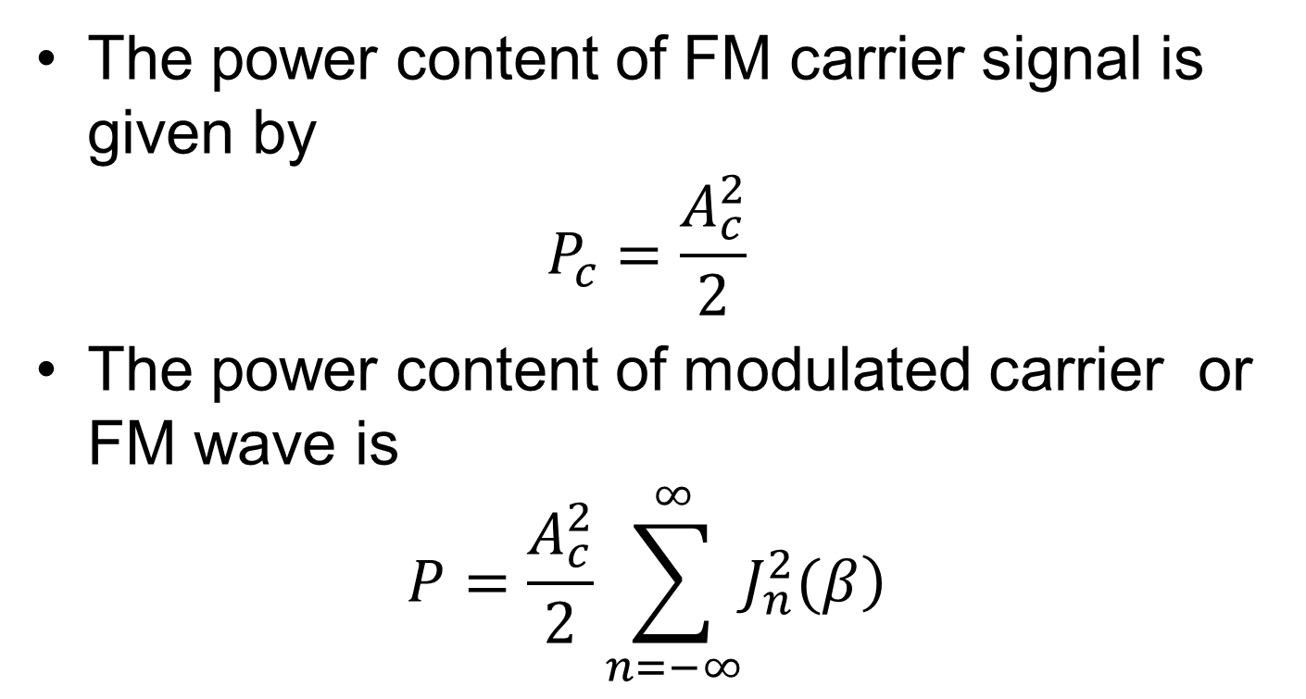
Power content of FM
The power content of FM carrier signal is given by
$$P_{c}=\frac{A_{c}^{2}}{2}$$
The power content of modulated carrier or FM wave is
$$P=\frac{A_{c}^{2}}{2}\sum_{n=−∞}^{∞}{\left.J_{n}^{2}(β\right)}$$
Notes:
For small value of B (beta) the function goes to 1

Slide 30
Example 5.3 pg 123
Let the carrier be given by c(t) = 10cos(2πf_{c}t) and let the message signal be cos(20πt)
Further assume that the message is used to frequency modulate the carrier with k_{f} = 50.
Find the expression for the modulated signal and determine how many harmonics should
be selected to contain 99% of the modulated signal power.

Slide 31
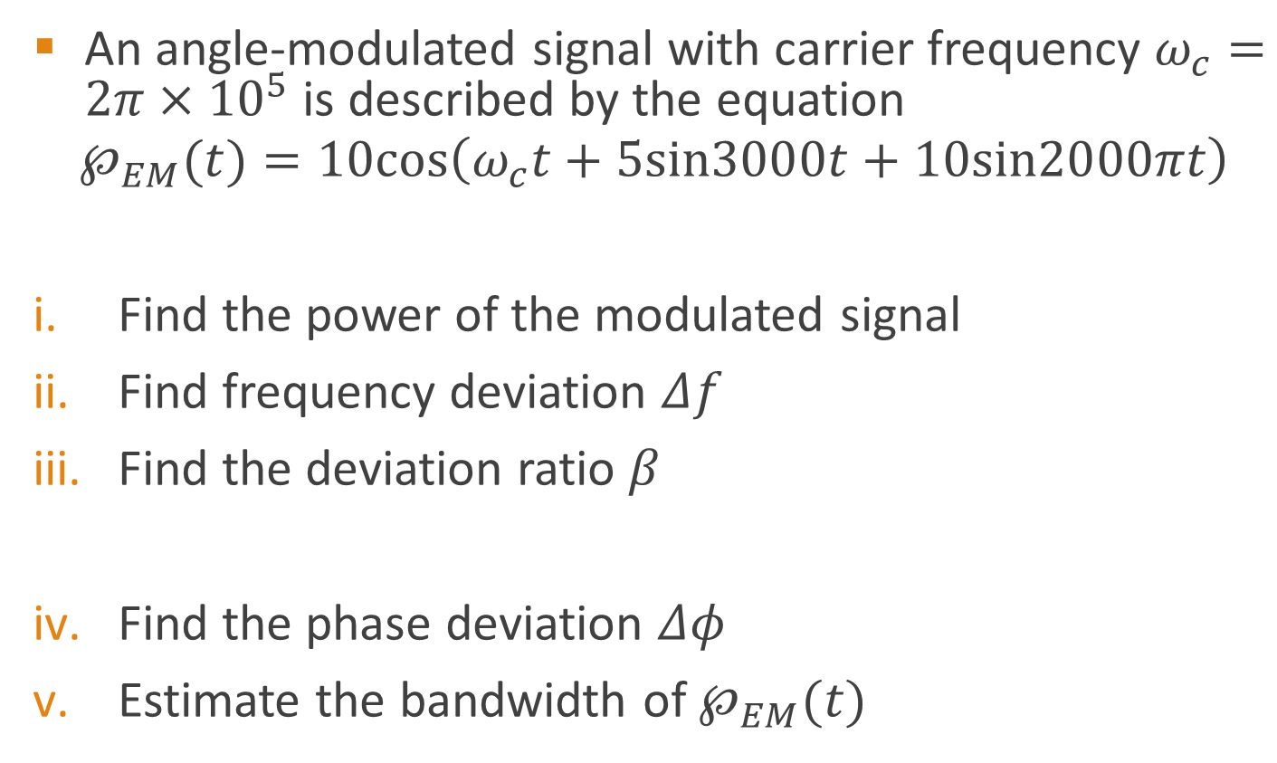


Example 5.1 pg 128
An angle-modulated signal with carrier frequency $ω_{c}=2π×{10}^{5}$ is described by the equation
$$℘_{EM}(t)=10cos\left(ω_{c}t+5sin3000t+10sin2000πt\right)$$
Find the power of the modulated signal
Find frequency deviation $Δf$
Find the deviation ratio $β$
Find the phase deviation $Δφ$
Estimate the bandwidth of $℘_{EM}(t)$
Note: The bandwidth is 1000 Hz, the highest freq. in m(t)
→Find the instantaneous freq. first
By differentiation → $ω_{i}=\frac{d}{dt}θi(t)$
Find max carrier deviation → get freq. deviation
→ We need $θi(t)$
→ Carson’s formula
Notes:
Pulse to explain
Note: The bandwidth is 1000 Hz, the highest freq. in m(t)
The two sinusoidal you get after derivative could add up at some point in time → we take their amplitude and add
The sum of the amplitudes of the sinusoid gives the phase deviation

Slide 32
Application of FM
Some of the applications of the FM modulation are listed below:
  FM Radio,(88 -108 MHz band, 75 kHz)
  TV sound broadcast, 25 kHz,
  Two-way mobile radio, 5 kHz / 2.5 kHz.

Slide 33
Advantages and disadvantages of FM over AM
Advantages of FM over AM are:
  Less radiated power.
  Low distortion due to improved signal to noise ratio (about 25dB) w.r.t. to man
  made interference.
  Smaller geographical interference between neighboring stations.
  Well defined service areas for given transmitter power.
Disadvantages of FM:
  Much more Bandwidth (as much as 20 times as much).
  More complicated receiver and transmitter.

